Slide 1
Taylor & Francis Research
(Hybrid) Open Select and Full Open Access Author Workflow

Slide 2
Workflow for an Open Select Article at Taylor & Francis
Research Dashboard
Article enters action required to be approved for OA funding via Research Dashboard
Acceptance
Article is accepted for publication and author is notified of the agreement
6
Published
Article is published as open online
4
Licence
2
Peer Review
Article enters peer review
Submission
Author submits article
5
1
3
Author chooses OA agreement
funds and signs a CC license
Information Classification: General

Slide 3
Email to author
on acceptance,
alerting them to
OA agreement
Send To: Author Email
Subject: Your article with Taylor & Francis
Body:
Dear Author First Name Last Name,
Re: Article Title; Journal Title
Congratulations on the recent acceptance of your manuscript submission to Journal Title. The Taylor & Francis production team will work with you to publish your article online as quickly as possible.
_____________has an open access agreement with Taylor & Francis, which means that as a corresponding author, you can publish your article open access at no cost to you.
What happens next?
Look out for an email inviting you to select and sign your article publishing agreement.
You may request approval by selecting the open access option. If your institution approves open access funding for your article, we will let you know.
If you have any questions, please do not hesitate to contact apc@tandf.co.uk, or your campus librarian.
Thank you,
Author

Slide 4
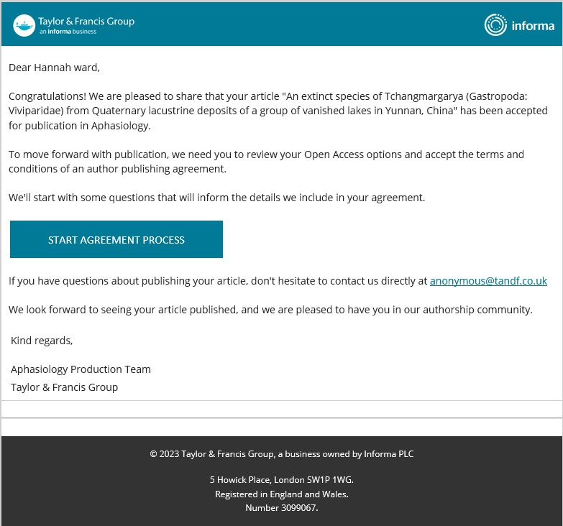
Author receives a link to the Author Publishing Agreement (APA)
Author

Slide 5
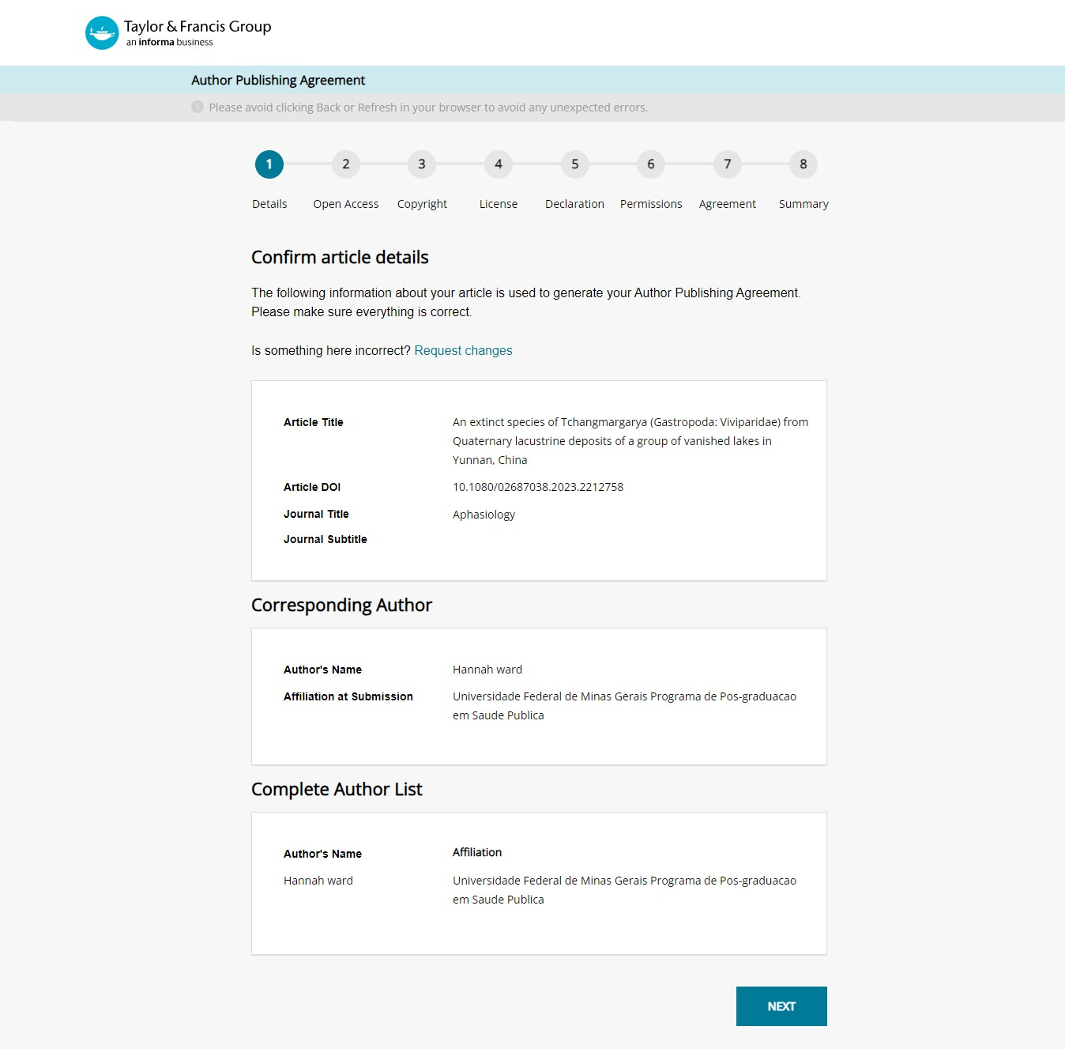
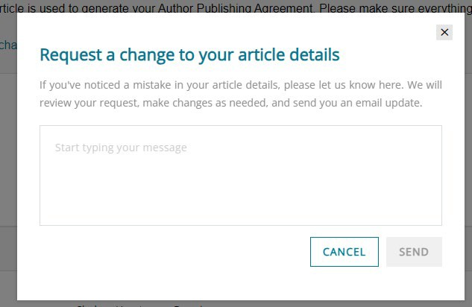
Author confirms article details
Author

Slide 6
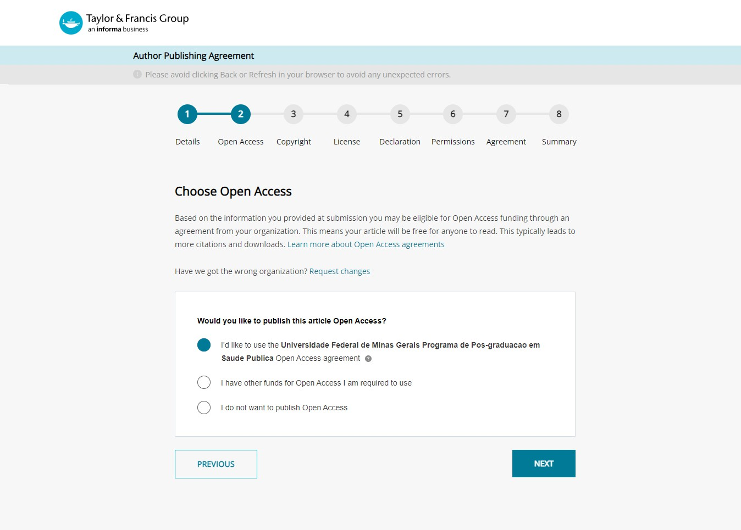
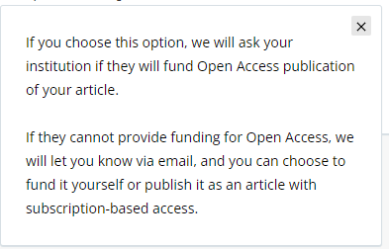
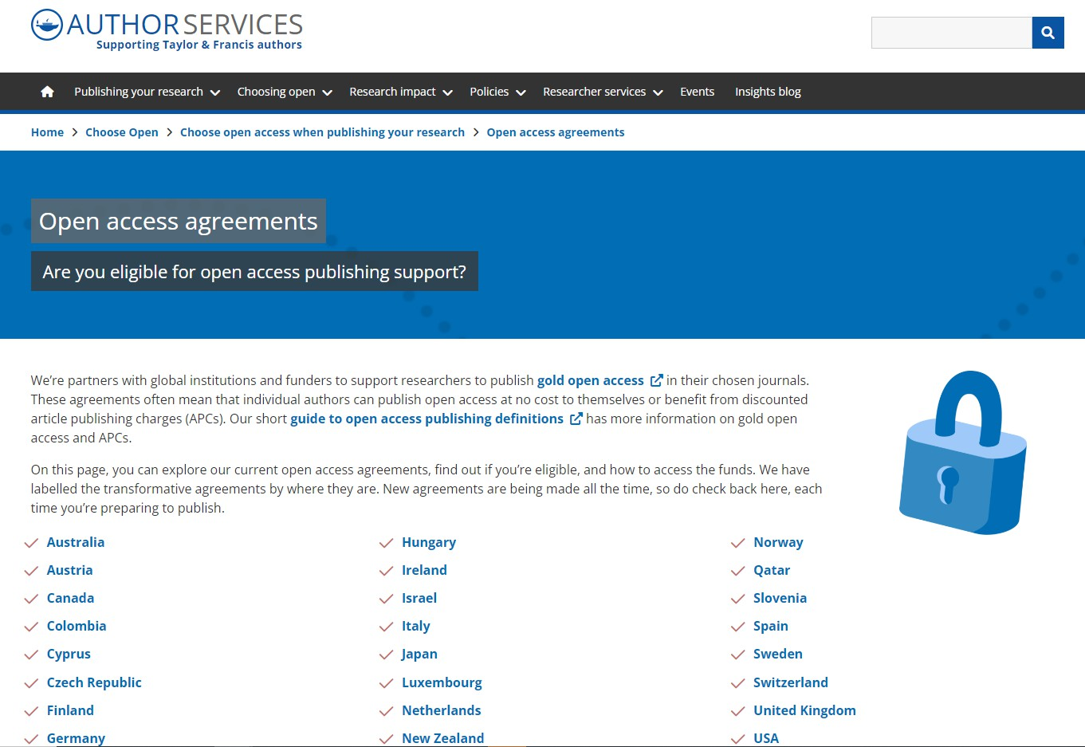
Author chooses if they would like to publish OA
Author

Slide 7
Default Workflow
Author

Slide 8
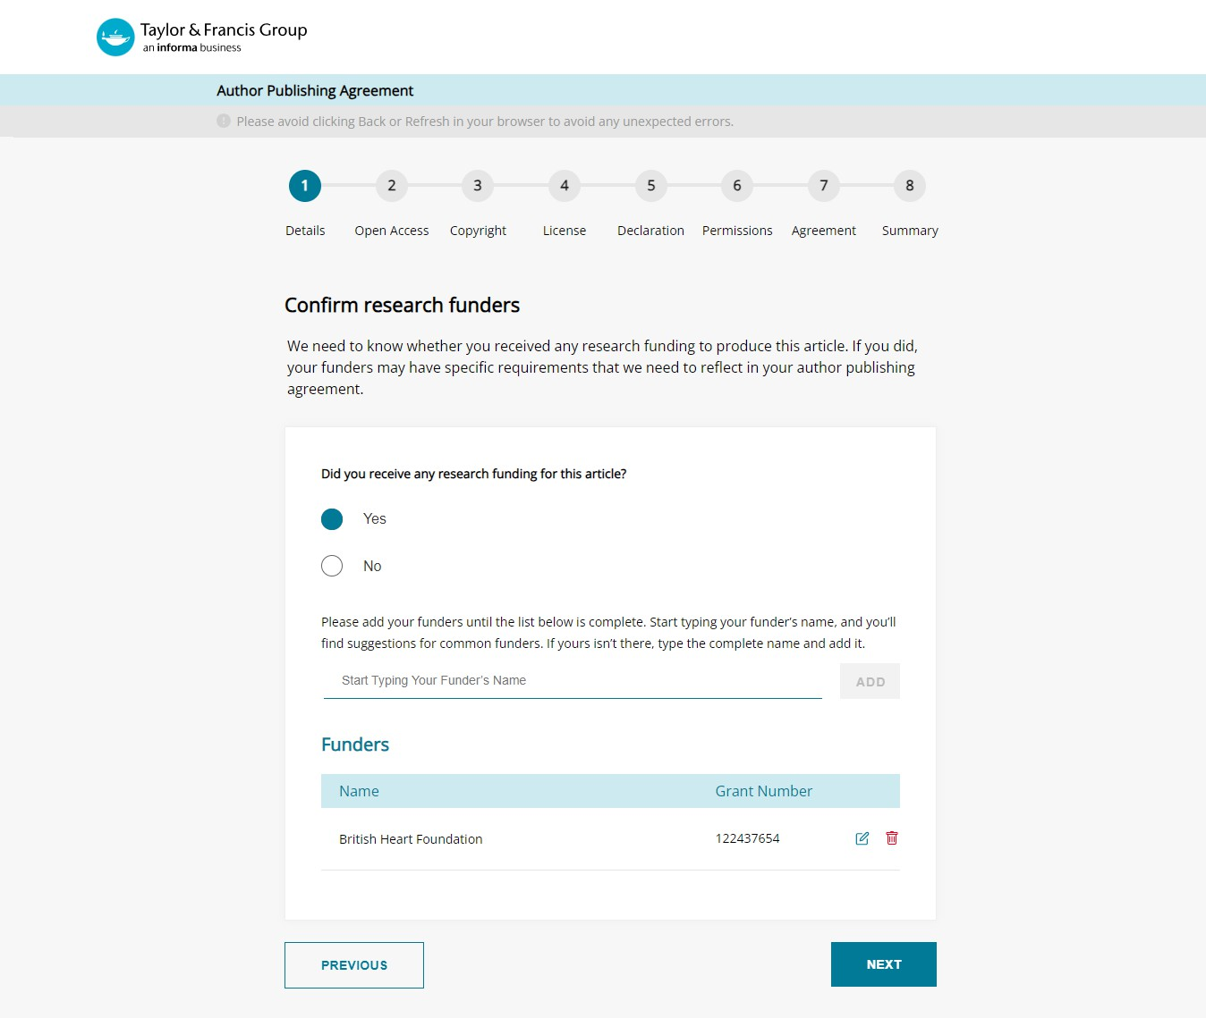
Author is prompted to confirm funder
Author

Slide 9
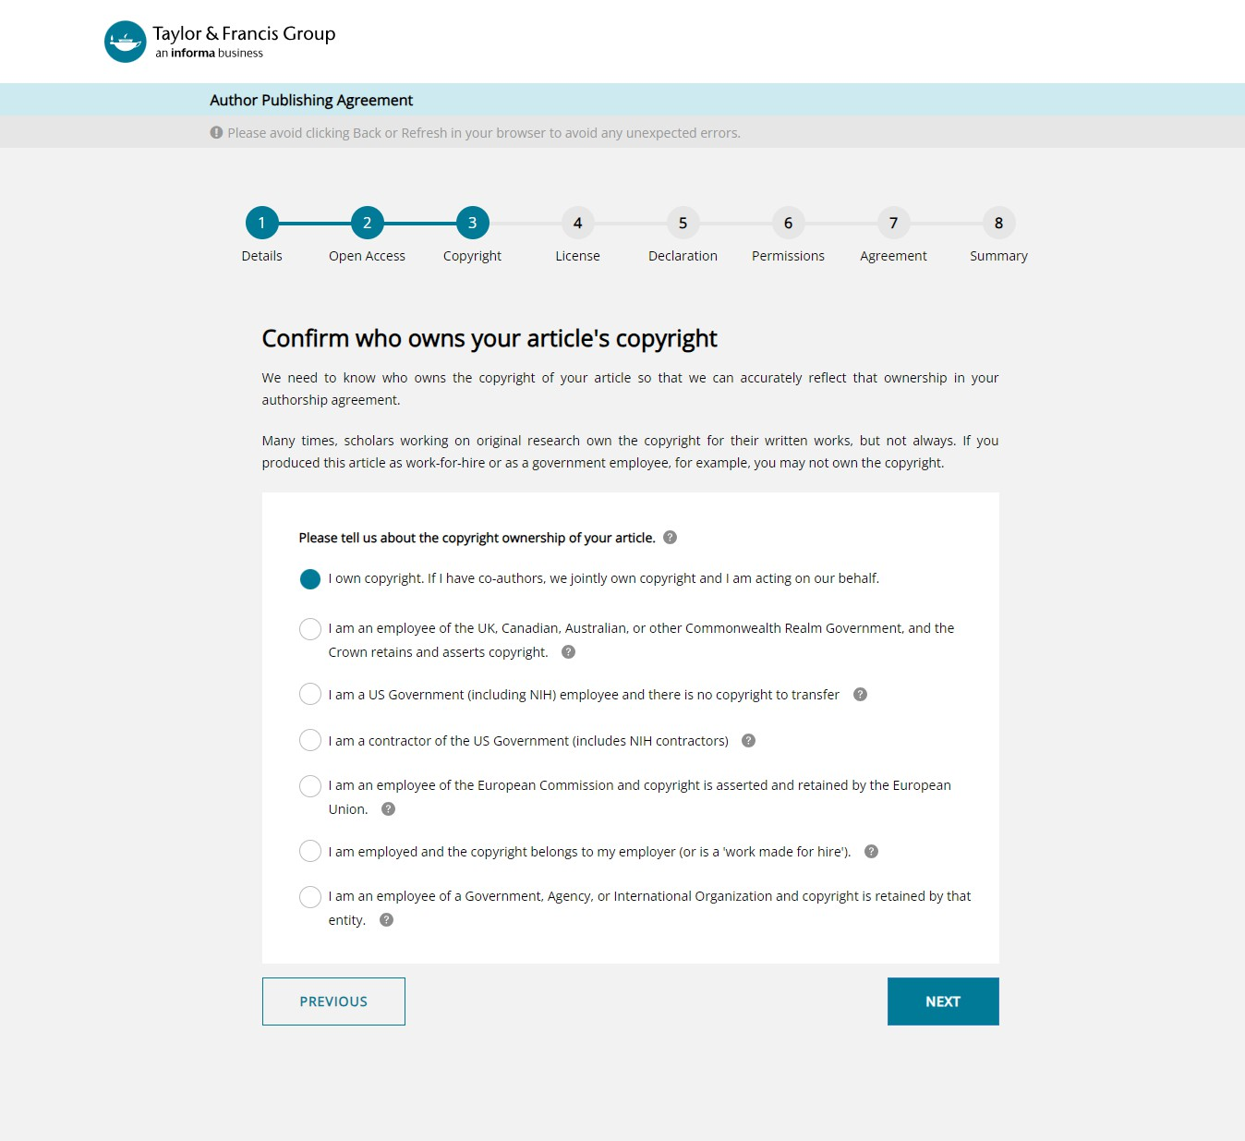
Author confirms who owns the copyright
Author

Slide 10
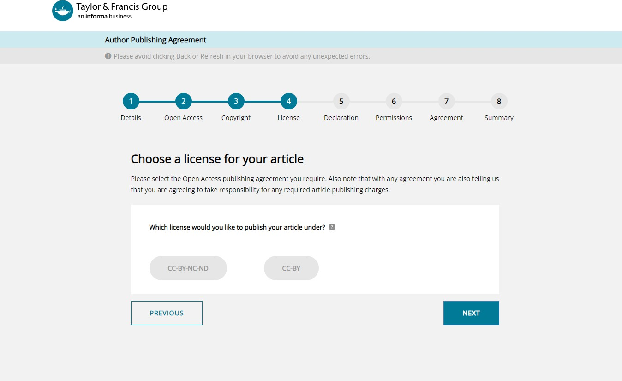
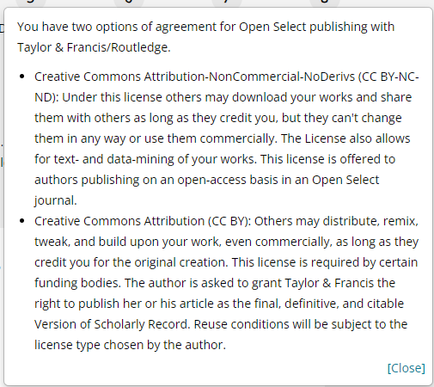
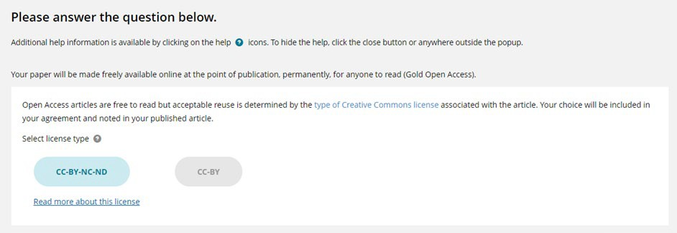
Author can
select their Creative commons licence
Author

Slide 11
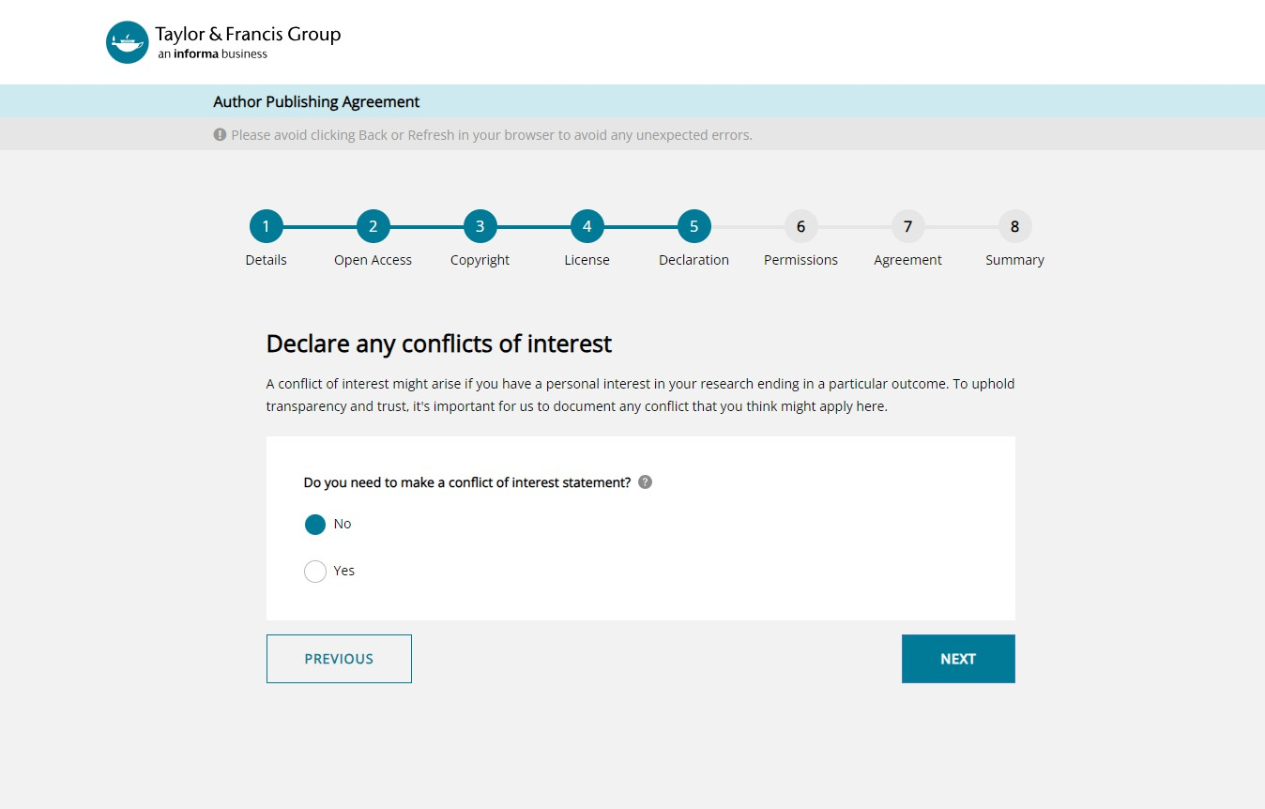
Author declares any conflict-of- interest
Author

Slide 12
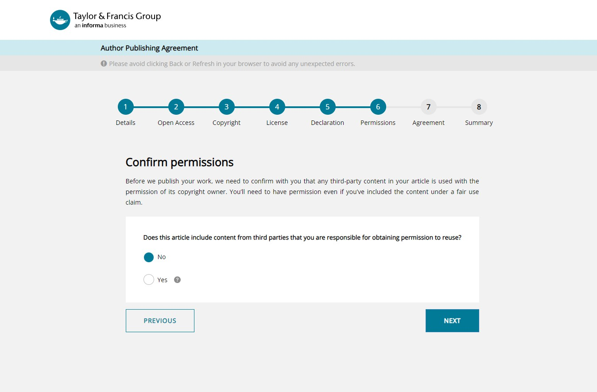
Author confirms permissions
Author

Slide 13
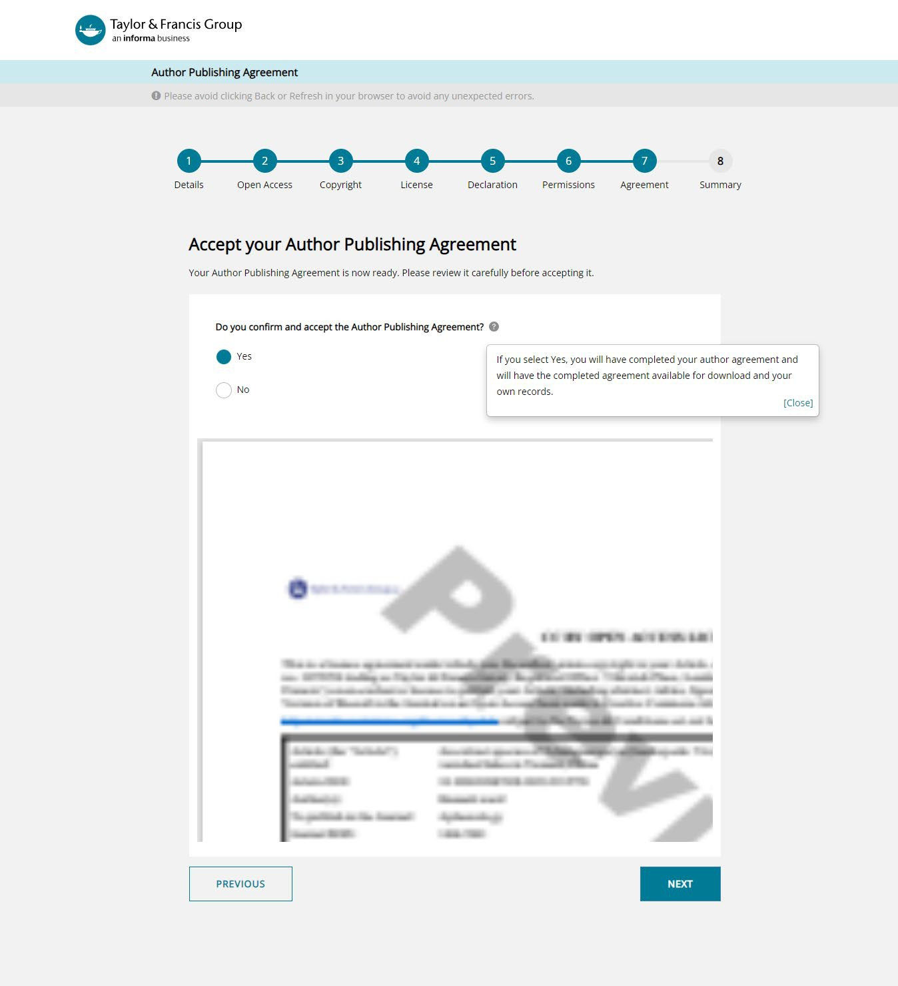
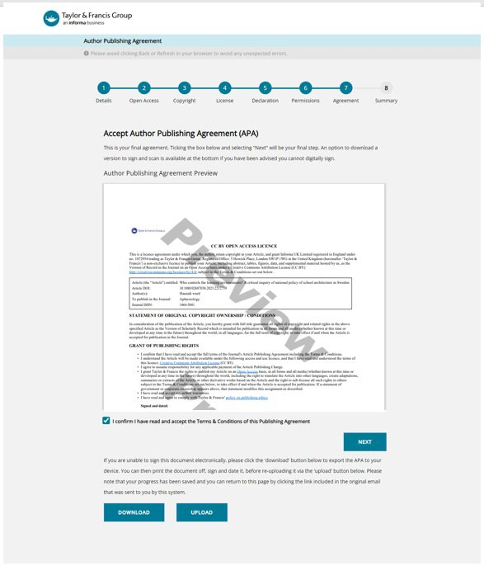
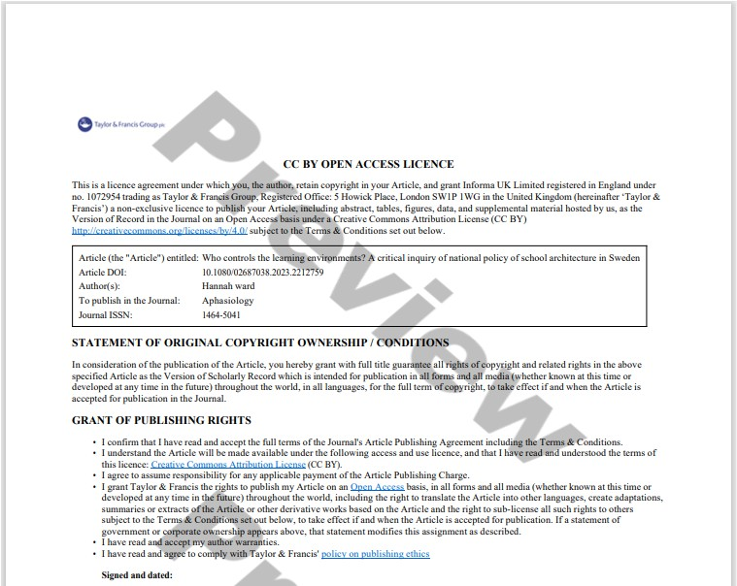
Author digitally signs the APA
Author

Slide 14
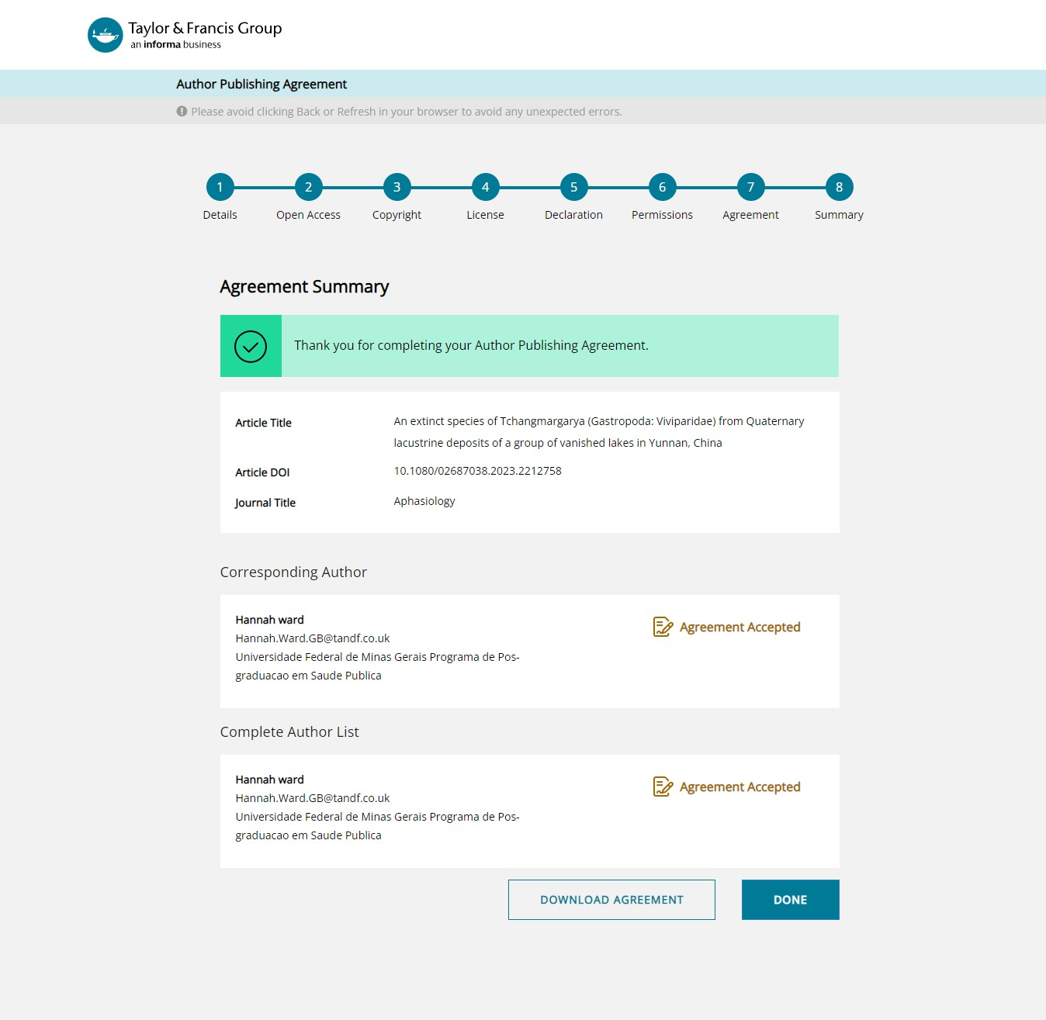
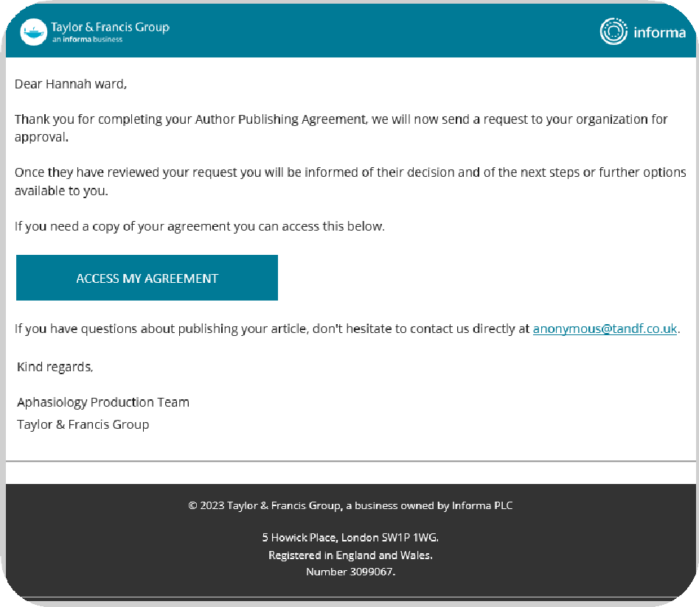
Author gets confirmation
Author

Slide 17
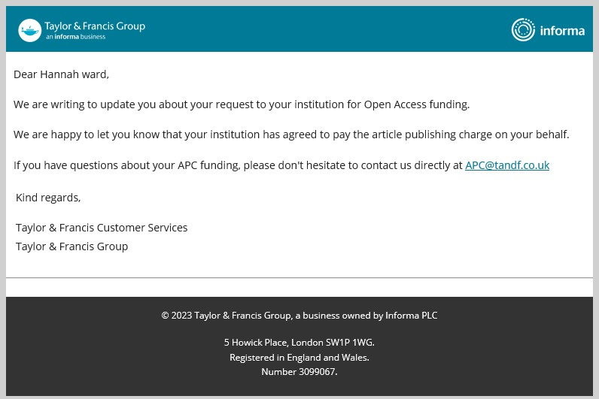
Author receives confirmation of OA funding
Author

Slide 18
Taylor & Francis Author Workflow & Research Dashboard
The Full OA Author Workflow

Slide 19
Workflow for an Open Article at Taylor & Francis
Research Dashboard
Article moves to Action Required to be approved for OA funding via Research Dashboard
Submission
Author submits article and is notified of agreement
Peer Review
Article enters peer review
6
Published
Article is published as open online
4
Acceptance & Licence
2
Research Dashboard
Article metadata enters submitted tab
5
1
3
Article is accepted for publication. The author signs a
CC licence

Slide 20
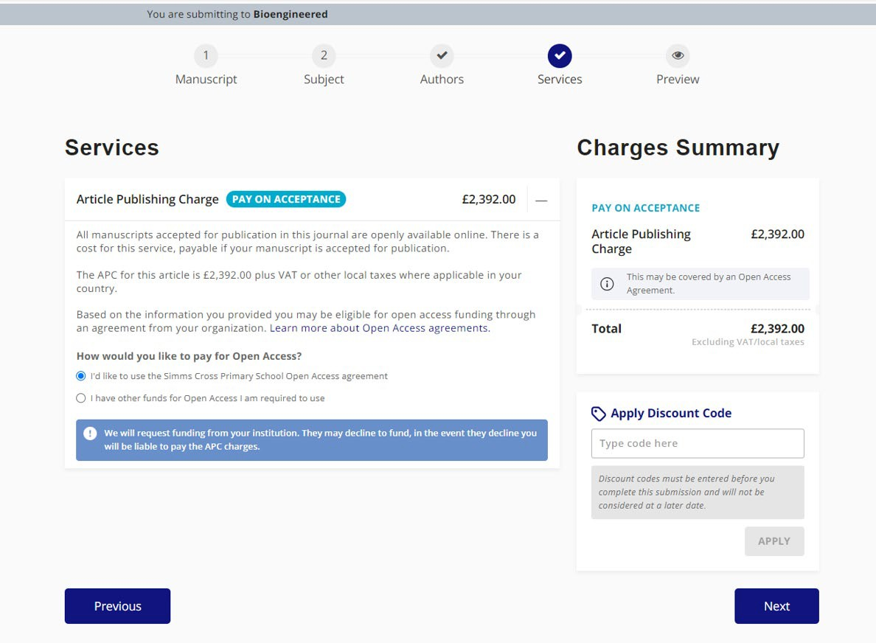
Author Submission Flow – Charges step
The system has recognized that the institution is part of the agreement and therefore directs the author to this page, letting them know that they are eligible for APC funding
37

Slide 21
Gracias

